Slide 1
Disciplines?
Relevance?
© A+ Computer Science - www.apluscompsci.com

Slide 2
Meaning?
1010
mixlplik
igpay atinlay
© A+ Computer Science - www.apluscompsci.com

Slide 3
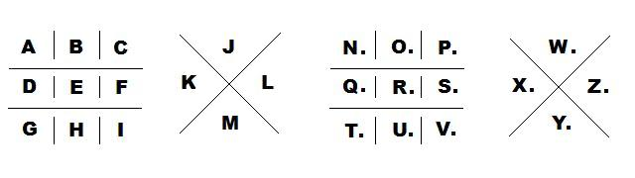

Codes
Ciphers
© A+ Computer Science - www.apluscompsci.com

Slide 4

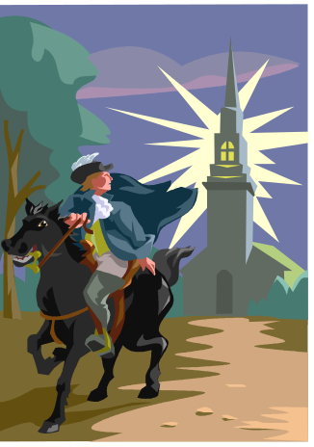

Codes and Ciphers
Codes and ciphers have existed for
hundreds of years.
People have always had the need
to hide secrets and messages.
© A+ Computer Science - www.apluscompsci.com

Slide 5
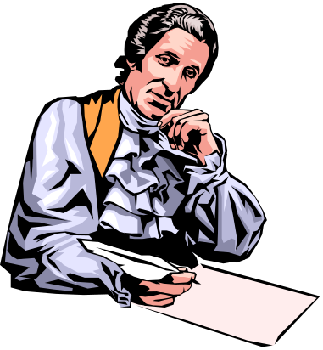
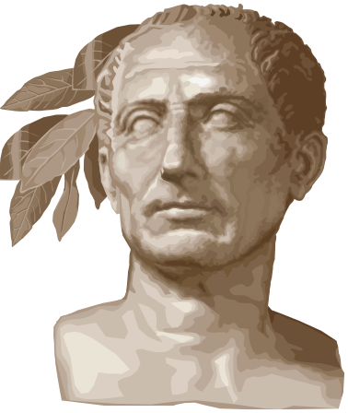

Codes and Ciphers
Caesar used ciphers and codes as did the
founding fathers of the United States.
Thomas Jefferson created ciphers and code systems during the American Revolution.
© A+ Computer Science - www.apluscompsci.com
Notes:
Add stuff here

Slide 6
Codes and Ciphers
Substitution ciphers are very common
ciphers. Letters can be reversed or rotated a certain amount.
A | B | C | D | E | F | G | H | I | J | K | L | M | N | O | P | Q | R | S | T | U | V | W | X | Y | Z
Y | Z | A | B | C | D | E | F | G | H | I | J | K | L | M | N | O | P | Q | R | S | T | U | V | W | X
Original Message : hello
Encoded Message : fcjjm
© A+ Computer Science - www.apluscompsci.com
Notes:
Add stuff here

Slide 7
Codes and Ciphers
A permutation can be used to make the substitution cipher harder to break.
A | B | C | D | E | F | G | H | I | J | K | L | M | N | O | P | Q | R | S | T | U | V | W | X | Y | Z
G | Y | W | J | M | N | A | Q | Z | D | X | V | E | F | T | S | H | U | P | O | R | L | C | I | B | K
Original Message : hello
Encoded Message : qmvvt
© A+ Computer Science - www.apluscompsci.com
Notes:
Add stuff here

Slide 8
Codes and Ciphers
Substitution ciphers are broken using letter frequencies. Certain letters occur in the English language more frequently than others. E occurs most frequently.
A | B | C | T
8.167 | 1.492 | 2.782 | 9.056
© A+ Computer Science - www.apluscompsci.com
Notes:
Add stuff here

Slide 9

Codes and Ciphers
Morse code is a very
common form
of cipher.
A | . _
B | _ . . .
C | _ . _ .
D | _ . .
E | .
Original Message : bad
Encoded Message : _ . . . . _ _ . .
© A+ Computer Science - www.apluscompsci.com
Notes:
Add stuff here

Slide 10
Codes and Ciphers
I | L | O | V
E | W | O | R
K | I | N | G
W | I | T | H
C | O | D | E
Transpositional ciphers come in many shapes and sizes.
These ciphers involve storing a message in
a grid and then encoding the message
using a specified pattern.
© A+ Computer Science - www.apluscompsci.com
Notes:
Add stuff here

Slide 11
Codes and Ciphers
A column cipher could just run down the columns to make a coded message.
I | L | O | V
E | W | O | R
K | I | N | G
W | I | T | H
C | O | D | E
Run down the columns starting with column 0.
CODED MESSAGE : IEKWCLWIIOOONTDVRGHE
© A+ Computer Science - www.apluscompsci.com
Notes:
Add stuff here

Slide 12
Codes and Ciphers
A spiral cipher typically spirals in
or out and starts at a specified corner.
I | L | O | V
E | W | O | R
K | I | N | G
W | I | T | H
C | O | D | E
Sprial from top left down and in
CODED MESSAGE : IEKWCODEHGRVOLWIITNO
© A+ Computer Science - www.apluscompsci.com
Notes:
Add stuff here

Slide 13
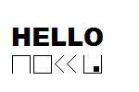
Codes and Ciphers
A pigpen cipher uses different shapes and dots to encode letters. The Freemasons are credited with creating the pigpen cipher.
© A+ Computer Science - www.apluscompsci.com
Notes:
Add stuff here

Slide 14
Codes and Ciphers
Letters can be placed in any order in the pigpen cipher.
© A+ Computer Science - www.apluscompsci.com
Notes:
Add stuff here

Slide 15

Codes and Ciphers
I | L | O | V | E
W | R | K | N | G
T | H | C | D | A
B | F | J | M | P
Q | S | U | V | X
A playfair cipher uses
a code phrase and
a 5X5 grid. No
duplicate letters
are placed in the grid.
The remaining letters of the alphabet are used to fill the grid.
It was used in WWI and WWII.
© A+ Computer Science - www.apluscompsci.com
Notes:
Add stuff here

Slide 16
Codes and Ciphers
I | L | O | V | E
W | R | K | N | G
T | H | C | D | A
B | F | J | M | P
Q | S | U | V | X
The letters to be
encoded must be
located in the grid.
FW is encoded to BR.
SV is encoded to UX.
EA is encoded to GP.
RD is encoded to NH.
© A+ Computer Science - www.apluscompsci.com
Notes:
Add stuff here

Slide 17
Codes and Ciphers
I | L | O | V | E
W | R | K | N | G
T | H | C | D | A
B | F | J | M | P
Q | S | U | V | X
Use the grid to
encode pairs of
letters.
MESSAGE TO CODE : WH AT
CODED MESSAGE : RT TH
© A+ Computer Science - www.apluscompsci.com
Notes:
Add stuff here

Slide 18
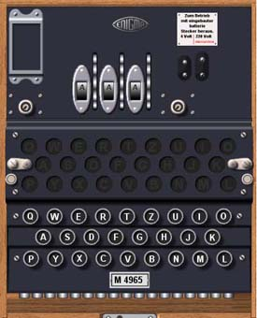
Codes and Ciphers
The enigma machine was used by the Nazi regime during World War II to encode messages.
Dave Reed’s Engima Machine
© A+ Computer Science - www.apluscompsci.com
Notes:
Add stuff here

Slide 19
Goto Wikipedia
Research Ciphers
Pick Any Cipher
© A+ Computer Science - www.apluscompsci.com

Slide 20
Where are
codes and ciphers
used today?
© A+ Computer Science - www.apluscompsci.com

Slide 21
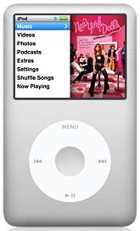
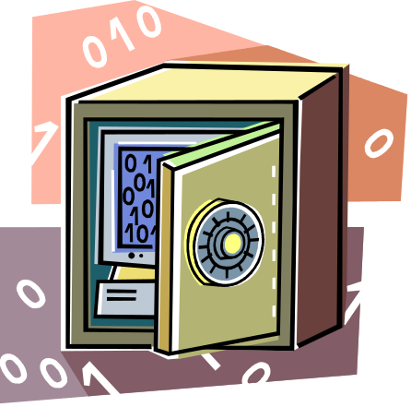

Codes and Ciphers
MPEG3 and MPEG4 files are encoded files.
MPEG stands for Moving Pictures Expert Group. MPEG files are compressed files.
© A+ Computer Science - www.apluscompsci.com
Notes:
Add stuff here

Slide 22
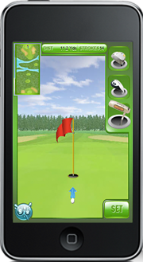
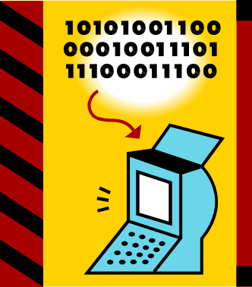
Codes and Ciphers
MP3 files are used to compress CD quality files. The compression algorithm typically compresses files at a 10mb to 1mb-2mb rate. A 40 mb file would compress roughly to 4mb-8mb.
© A+ Computer Science - www.apluscompsci.com
Notes:
Add stuff here

Slide 23


Codes and Ciphers
You must have an MPEG3 compatible player to play an MPEG3 encoded file.
© A+ Computer Science - www.apluscompsci.com
Notes:
Add stuff here

Slide 24
Create a Cipher
Program Using
Any Language / Tool
© A+ Computer Science - www.apluscompsci.com

